Slide 1
Delta rule, gradient Descent and Back propagation algorithm

Slide 2
Delta Rule and Gradient descent
Perceptron training rule finds a successful weight vector when the training examples are linearly separable, it can fail to converge if the examples are not linearly separable.
A second training rule , called delta rule, converges toward a best fit approximation, if the training examples are not linearly separable.
Delta rule uses gradient descent to search the hypothesis space of possible weight vectors to find the weights that best fit the training examples.
Gradient descent provides the basis for the back propagation algorithm, which can learn networks with many inter connected units.

Slide 3
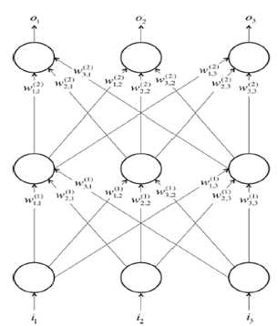
Feed forward neural network

Slide 4
Multi Layer neural network
Input Layer: The bottom layer of the network pulls in the input data.
Output Layer: The top layer of neurons (output nodes) computes our final answer.
Hidden layer: The middle layer of neurons in between input and output layers are called the hidden layers.
we let w_{i, j}^{(k)} be the weight of the connection between the i^{th} neuron in the k^{th} layer with the j^{th} neuron in the
k + 1st layer.
These weights constitute the parameter vector θ.
The ability to solve problems with neural networks depends on finding the optimal values to plug into θ.

Slide 5
Feed-forward networks
Connections only traverse from a lower layer to a higher layer.
There are no connections between neurons in the same layer, and there are no connections that transmit data from a higher layer to a lower layer.
These neural networks are called feed-forward networks
Depending on the complexity of the problem, number of hidden layers may be more than 1.

Slide 6
Feed forward network cont..
It is not necessary that every layer has the same number of neurons. More often, hidden layers have fewer neurons than the input layer to force the network to learn compressed representations of the original input.
For example, while our eyes obtain raw pixel values from our surroundings, our brain thinks in terms of edges and contours.
It is not required that every neuron has its output connected to the inputs of all neurons in the next layer.
Selecting which neurons to connect to which other neurons in the next layer is an art that comes from experience

Slide 7
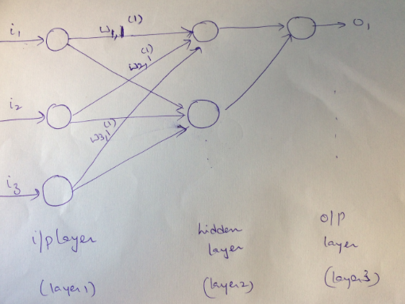

Slide 8
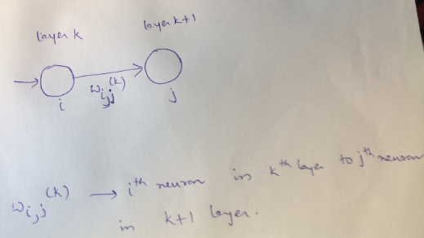

Slide 9
Linear neurons and limitations
Linear neurons are easy to compute with, but they run into serious limitations.
In fact, it can be shown that any feed-forward neural network consisting of only linear neurons can be expressed as a network with no hidden layers.
This is problematic because, hidden layers are what enable us to learn important features from the input data.
In other words, in order to learn complex relationships, we need to use neurons that employ some sort of nonlinearity

Slide 10

Error function E
During training, we show the neural net a large number of training examples and iteratively modify the weights to minimize the errors we make on the training examples.
we want to minimize the square error over all of the training examples that we encounter
the closer E is to 0, the better our model is
our goal will be to select our parameter vector θ (the values for all the weights in our model) such that E is as close to 0 as possible

Slide 11
Gradient Descent
If we visualize how we might minimize the squared error over all of the training examples by simplifying the problem.
If there are two weights, w1 and w2, then we can imagine a three-dimensional space where the horizontal dimensions correspond to the weights w1 and w2, and the vertical dimension corresponds to the value of the error function E.
In this space, points in the horizontal plane correspond to different settings of the weights, and the height at those points corresponds to the incurred error.

Slide 12
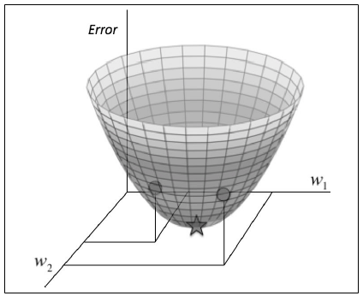
If we consider the errors we make over all possible weights, we get a surface in this three-dimensional space, in particular, a quadratic bowl.

Slide 13
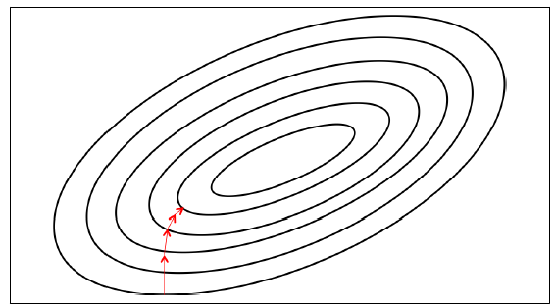
We can also conveniently visualize this surface as a set of ellipticalcontours, where the minimum error is at the center of the ellipses.

Slide 14
In this setup, we are working in a two- dimensional plane where the dimensions correspond to the two weights.
Contours correspond to settings of w1 and w2 that evaluate to the same value of E.
The closer the contours are to each other, the steeper the slope.
In fact, it turns out that the direction of the steepest descent is always perpendicular to the contours.
This direction is expressed as a vector known as the gradient.

Slide 15
This algorithm is known as gradient descent, and we’ll use it to tackle the problem of training individual neurons and the more general challenge of training entire network.

Slide 16
Hyper parameter- Learning Rates
In addition to the weight parameters defined in our neural network, learning algorithms also require a couple of additional parameters to carry out the training process.
One of these hyper parameters is the learning rate.
at each step of moving perpendicular to the contour, we need to determine how far we want to walk before recalculating our new direction.
This distance needs to depend on the steepness of the surface.

Slide 17
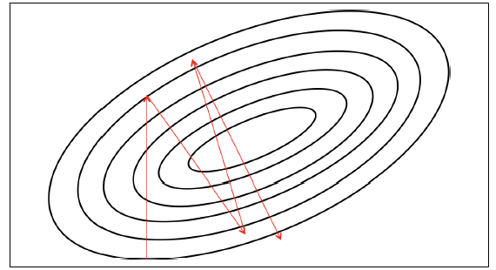
The closer we are to the minimum, the shorter we want to step forward.
we multiply the gradient by a factor , learning rate.
Picking the learning rate is a hard problem, if we pick a learning rate that’s too small, we risk taking too long during the training process.
But if we pick a learning rate that’s too
big, we’ll mostly likely start diverging away from the minimum.

Slide 18
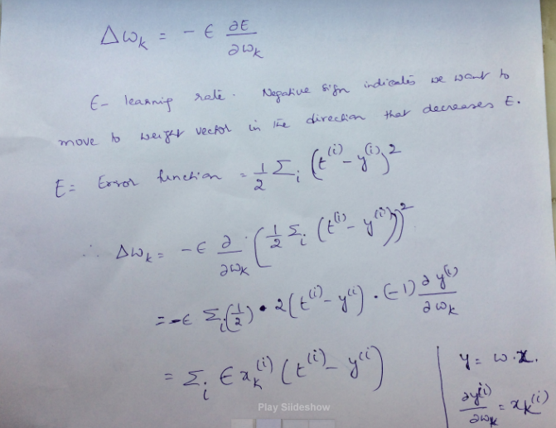
Delta rule for training linear neurons In order to calculate how to change each weight, we evaluate the gradient,which is partial derivative of error function wrt each of the weights.

Slide 19
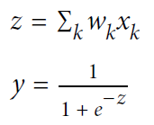
Gradient Descent with sigmoidal neurons –to train neurons that utilize nonlinearity
Let us assume that neurons use bias term –for simplicity of derivation
Output of the neuron is computed from its inputs as:

Slide 20
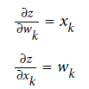

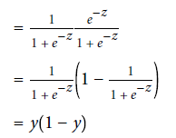
Derivative of logit Z wrt inputs and weights:
Derivative of Output wrt logit is:

Slide 21
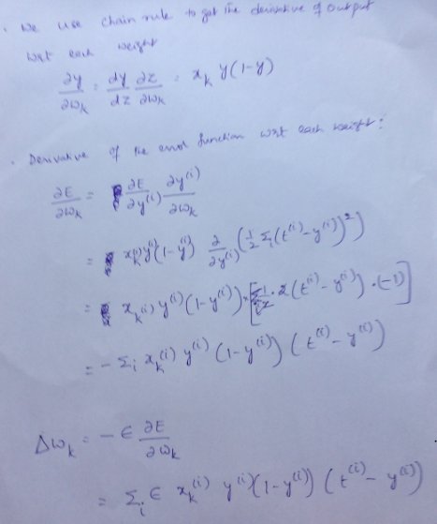

Slide 22
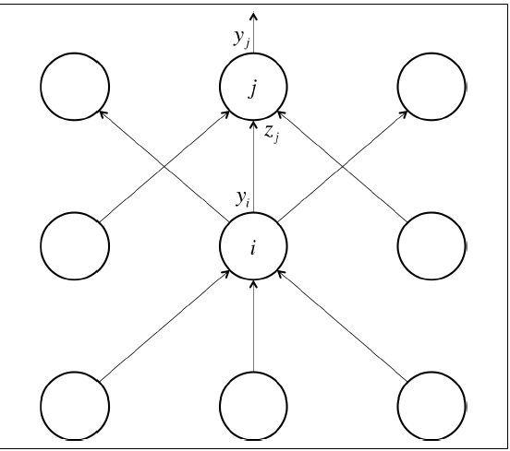
Back propagation algorithm

Slide 23


The error function derivatives at the output layer
$−\sum_{j ∈output}{(t}j−yj)$

Slide 24


Back propagation Algorithm
The partial derivative of the logit with respect to the incoming output data from the layer beneath is merely the weight of the connection w_{ij}
We can write the first term as

Slide 25

Combining these two together, we can find he error derivatives of layer i in terms of the error derivatives of layer j:
After finding the error function with respect to the hidden unit activities, we can then determine how the error changes with respect to the weights.
This gives us how to modify the weights after
each training example:

Slide 26

Back propagation Algorithm
Finally, to complete the algorithm, we merely sum up the partial derivatives over all the training examples in our dataset.

Slide 27
Gradient Descent (GD) Optimization
In gradient descent the error surface is computed and then it follow the gradient to take the path of steepest descent
Using the Gradient Decent optimization algorithm, the weights are updated incrementally after each epoch (= a pass over the training dataset).

Slide 28
Batch Gradient Descent
The Back propagation Algorithm we discussed uses a version of gradient descent known as batch gradient descent.
In batch gradient descent, the entire dataset is used to compute the error surface
For a simple quadratic error surface, this works quite well.
But in most cases, our error surface may be a lot more complicated

Slide 29
Batch Gradient Descent
The larger the training set, the slower the algorithm updates the weights
And the longer it may take until it converges to the global cost minimum (note that the SSE cost function is convex).
It is difficult for datasets that don't fit in memory.
Batch gradient descent also doesn't allow us to update the model online, i.e. with new examples on-the-fly.

Slide 30
Stochastic and Mini batch Gradient Descent
In Stochastic Gradient Descent (sometimes also referred to as iterative or on-line gradient descent)
we update the weights after each training sample
Batch gradient descent performs redundant computations for large datasets, as it recomputes gradients for similar examples before each parameter update.

Slide 31
SGD
SGD does away with this redundancy by performing one update at a time.
It is therefore usually much faster and can also be used to learn online.
SGD performs frequent updates with a high variance that cause the objective function to fluctuate heavily as in Image shown in next slide.

Slide 32
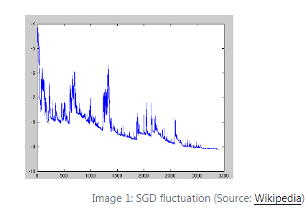
As SGD will keep overshooting, complicates convergence to the exact minimum. That make gradient descent take a significant amount of time.

Slide 33
Mini batch gradient descent
Mini-batch gradient descent takes the best of both worlds.
It performs an update for every mini-batch of n training examples.
Minibatches strike a balance between the efficiency of batch gradient descent and the local-minima avoidance afforded by stochastic gradient descent.

Slide 34

Mini batch Gradient Descent
In the context of back propagation, our weight update step becomes
instead of summing over all the examples in the dataset, we sum over the examples in the current mini batch

Slide 35
Test sets, validation sets and overfitting –
One of the major issues with artificial neural networks is that the models are quite
complicated.
Example for overfitting-We are given a bunch of data points on a flat plane, and our goal is to find a curve that best describes this dataset (i.e., will allow us to predict the y-coordinate of a new point given its x-coordinate).
Using the data, we train two different models: a linear model and a degree 12 polynomial.

Slide 36
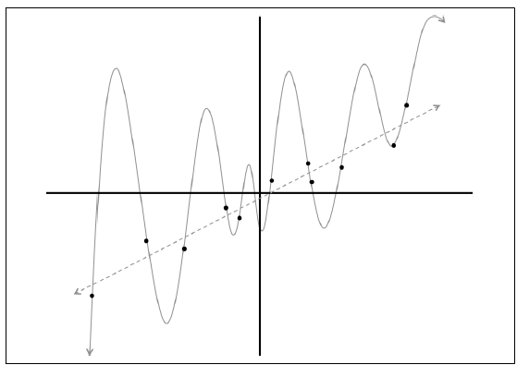
Which curve should we trust? The line which gets almost no training example correctly? Or the complicated curve that hits every single point in the dataset?
At this point we might trust the linear fit because it seems much less artificially created.

Slide 37
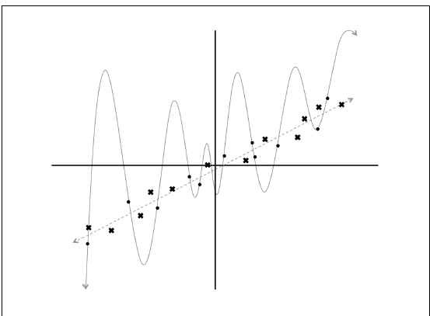
let’s add more data to our dataset!
Now, the linear model is not only better subjectively but also quantitatively (measured using the squared error metric

Slide 38
Overfitting
This leads to a very interesting point about training and evaluating machine learning models.
By building a very complex model, it’s quite easy to perfectly fit our training dataset because we give our model enough degrees of freedom to itself to fit the observations in the training set.
But when we evaluate such a complex model on new data, it performs very poorly.
In other words, the model does not generalize well .

Slide 39
This is a phenomenon is called overfitting.
It is one of the biggest challenges that a machine learning engineer must combat.
This becomes an even more significant issue in deep learning, where our neural networks have large numbers of layers containing many
neurons.

Slide 40
This leads to three major observations. First, the machine learning engineer is always working with a direct trade-off between overfitting and model complexity.
If the model isn’t complex enough, it may not be powerful enough to capture all of the useful information necessary to solve a problem.
However, if our model is very complex (especially if we have a limited amount of data at our disposal), we run the risk of overfitting.
Deep learning takes the approach of solving very complex problems with complex models and taking additional countermeasures to prevent overfitting.

Slide 41
Training and Test data
Second, it is very misleading to evaluate a model using the data we used to train it. Using the previous example , this would falsely suggest that the degree 12 polynomial model is preferable to a linear fit.
As a result, we almost never train our model on the entire dataset.
Instead, we split up our data into a training set and a test set.
This enables us to make a fair evaluation of our model by directly measuring how well it generalizes on new data it has not yet seen.

Slide 42
Validation set
Third, it’s quite likely that while we’re training our data, there’s a point in time where instead of learning useful features, we start overfitting to the training set.
To avoid that, we want to be able to stop the training process as soon as we start overfitting, to prevent poor generalization. To do this, we divide our training process into epochs.
An epoch is a single iteration over the entire training set. In other words, if we have a training set of size d and we are doing mini-batch gradient descent with batch size b, then an epoch would be equivalent to d/b model updates.
At the end of each epoch, we want to measure how well our model is generalizing. To do this, we use an additional validation set

Slide 43
Validation set
So, the dataset is divided into Training, Validation and Test data in deep learning.
At the end of an epoch, the validation set will tell us how the model does on data it has yet to see.
If the accuracy on the training set continues to increase while the accuracy on the validation set stays the same (or decreases), it’s a good sign that it’s time to stop training because we’re overfitting.

Slide 44
Hyper parameter optimization
The validation set is also helpful as a proxy measure of accuracy during the process of hyperparameter optimization.
One potential way to find the optimal setting of hyperparameters is by applying a grid search, where
we pick a value for each hyperparameter from a finite set of options (e.g., learning rate ∈ 0 . 001, 0 . 01, 0 . 1 , batch size ∈ 16, 64, 128 , ...), and train the model with every possible permutation of hyperparameter choices.
We elect the combination of hyperparameters with the best performance on the validation set, and report the accuracy of the model trained with best combination on the test set.

